Slide 1
DATA, DESIGN & THE CITY
JAMES STEWART & MORGAN CURRIE
20 MARCH 2019

Slide 2
JUST write
If my course project carried on into the future, I could see it make an impact by…
My project could be an effective part of a campaign that asks people to…

Slide 3
ANNOUNCEMENTS

Slide 4
Catrina Randall
From Friends of Earth Scotland and The Shrub
Notes:
All flat maps of the earth are projections, attempts to represent a globe on a single surface. Every projection is a distortion, but the nature of the distortions varies depending on the ways the images are constructed and the purpose they are meant to serve. Maps for navigation are very different than those used to show geologic features, for instance.

Slide 5
Data Visualisation for Advocacy

Slide 6
Tactical Tech:
Exploring ‘known knowns’. Make information immediately relevant and consider engaging people through participation and crowdsourcing
Exploring ‘unknown knowns’. Help people think more clearly about a project and connect the dots
Exploring ‘unknown unknowns’. Investigative work to uncover and visualise hard to find information
Notes:
Typically everyday citizens are not equipped to gather scientific evidence. Usuallyit’s governments or academics or journalists who do this. Sometimes for-profit companies and non-profits. So the next question is, how can civil society develop tools and practices to support real, effective participation in science and evidence-making processes?

Slide 7
Tactical Tech:
What is the point?
Consider whether the data needs to be simplified, contextualised or completed with other data
Does it frame the data in succinct and compelling ways without misleading or over-generalising?
Is the information presented in an engaging way? How can the visual design help organise and give meaning to the data?
Notes:
Typically everyday citizens are not equipped to gather scientific evidence. Usuallyit’s governments or academics or journalists who do this. Sometimes for-profit companies and non-profits. So the next question is, how can civil society develop tools and practices to support real, effective participation in science and evidence-making processes?

Slide 8
Tactical Tech:
A good information graphic :
provides a concise visual entry-point that at first glance invites us to examine the image further.
presents something that we weren’t quite expecting, or gives us perspective on something out of context.
communicates something that the audience may not have known, understood or reflected on before.
leaves the viewer with an open question, or hook, leading them to search for more information, reconsider their views, or get more engaged.
Notes:
Typically everyday citizens are not equipped to gather scientific evidence. Usuallyit’s governments or academics or journalists who do this. Sometimes for-profit companies and non-profits. So the next question is, how can civil society develop tools and practices to support real, effective participation in science and evidence-making processes?

Slide 9
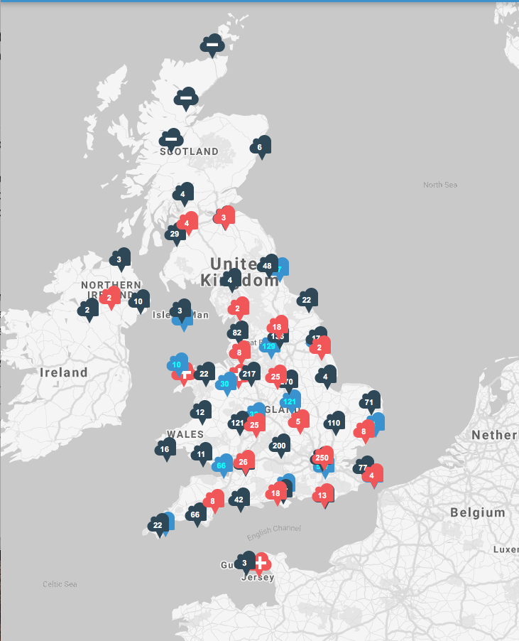
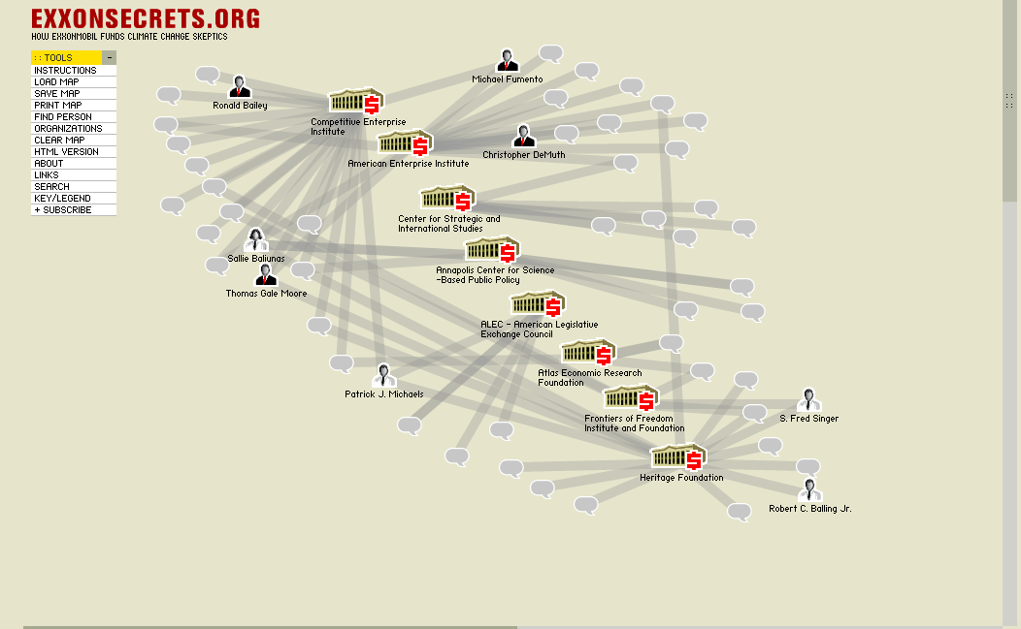
Notes:
citizen science is a way to get bottom-up and emergent evidence-making initiatives from citizens and activists.

